Slide 1

Bitcoin
Show me the Money????

Slide 2
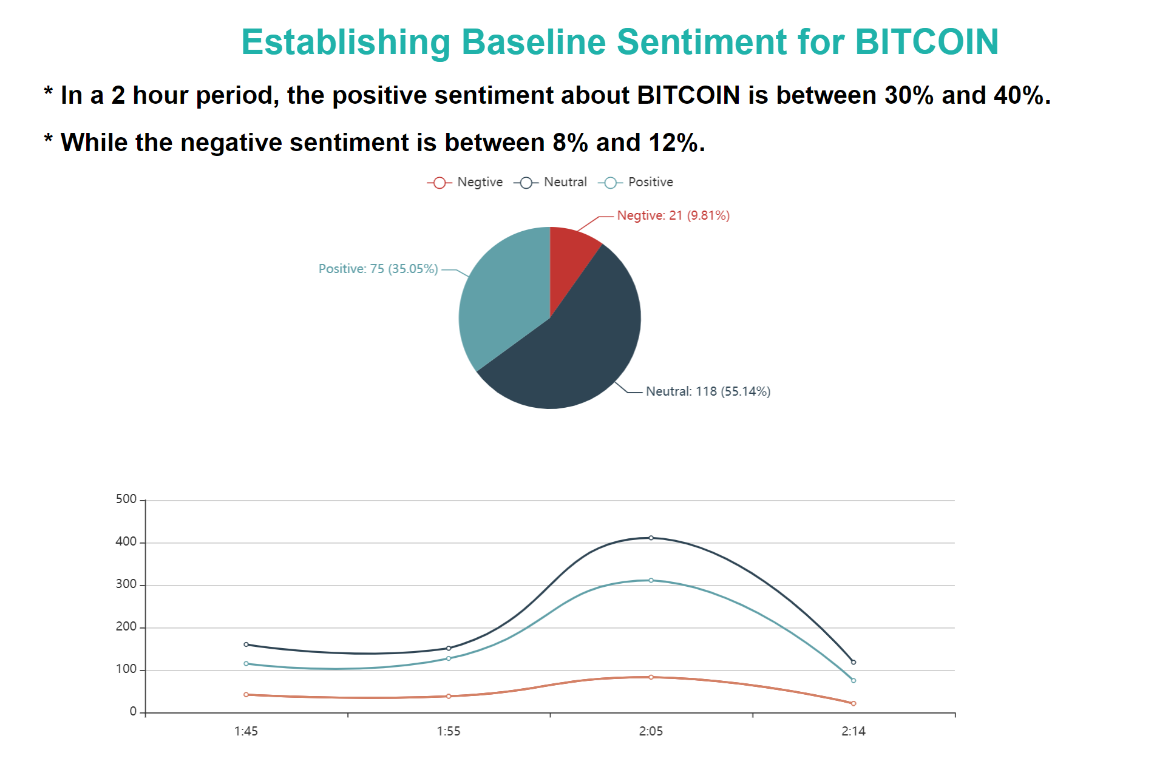

Slide 3
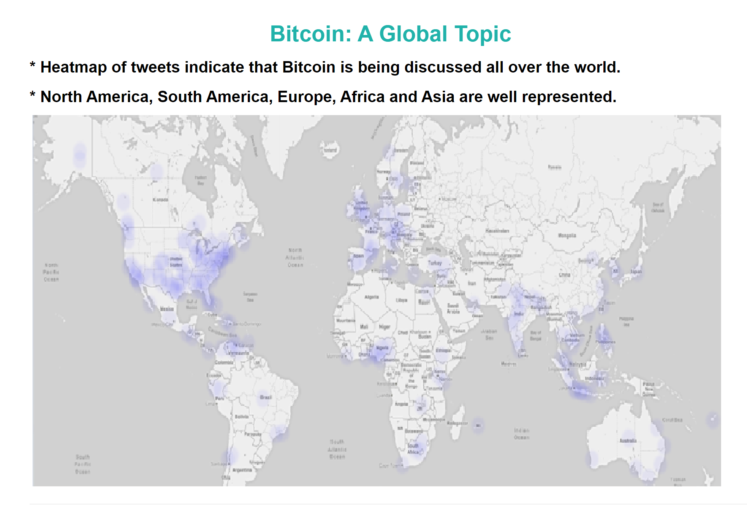

Slide 4
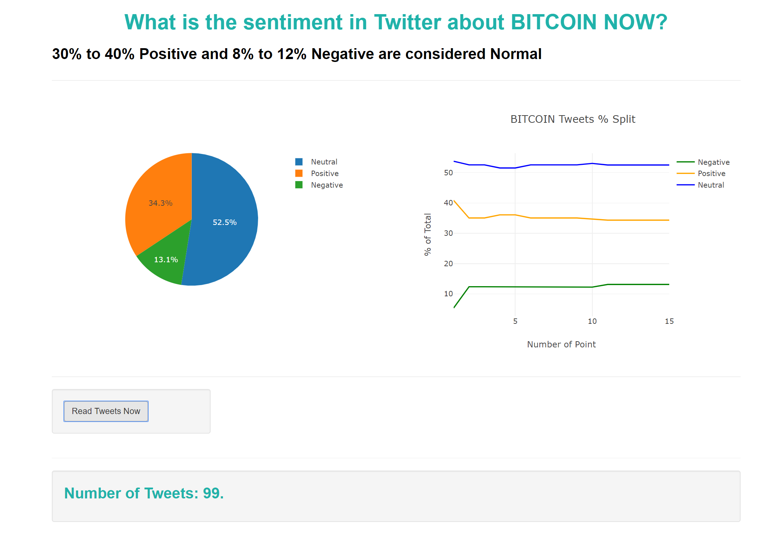

Slide 5
